Slide 1


Movement Primitive Analysis for Movement Recognition A Neuro-AI Pipeline Using Markerless Motion Capture
Arefeh Farahmandi
April 2025

Slide 2
Movement Recognition
What are primitives that distinguish different movements?
Are those primitives aligning with our movement perception?
Can we use these primitives to enhance ML applications?
Movements decomposed into fundamental building blocks called movement primitives, which the nervous system combines flexibly to produce coordinated actions. (Knopp et al. 2020)

Slide 3
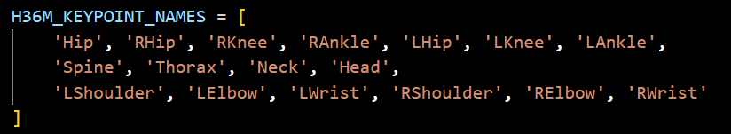
Process
TMP model
TMP model requires 3D pose motion data:
VIBE : requires multiple view videos
DeepLabCut : requires multiple Camera Calibration
Mmpose : Powerful toolbox for 3D pose extraction
Simple 2D Video
3D pose
Motion Capture
Movement primitives

Slide 4
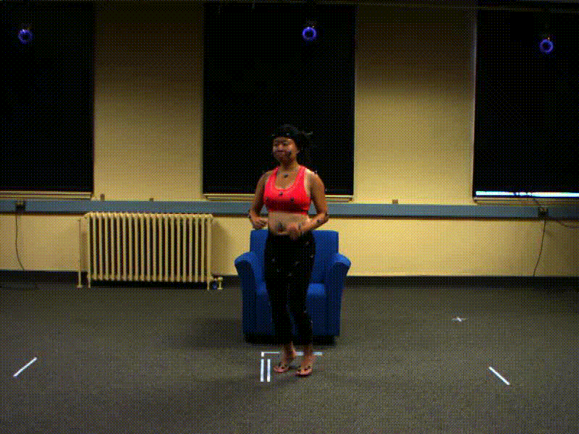
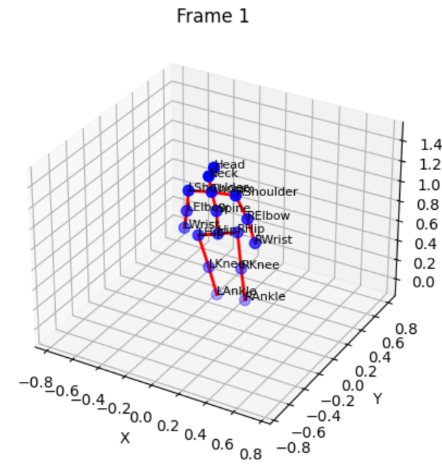
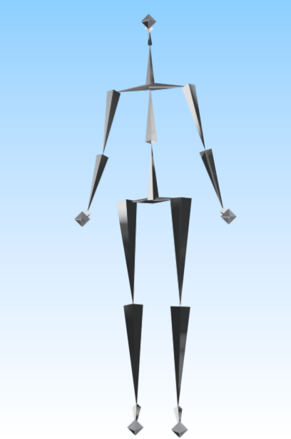
Data processing
1-Original 2D video
2-MMpose 3D extraction
3-Motion Capture .bvh

Slide 5
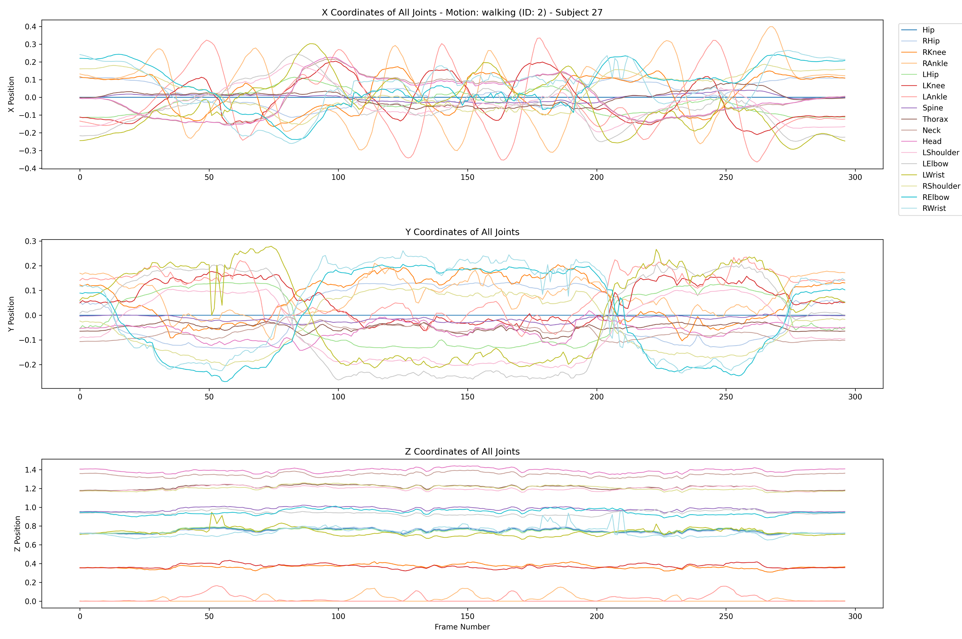
3D pose data
Motion: walking
Subject_id : 27

Slide 6
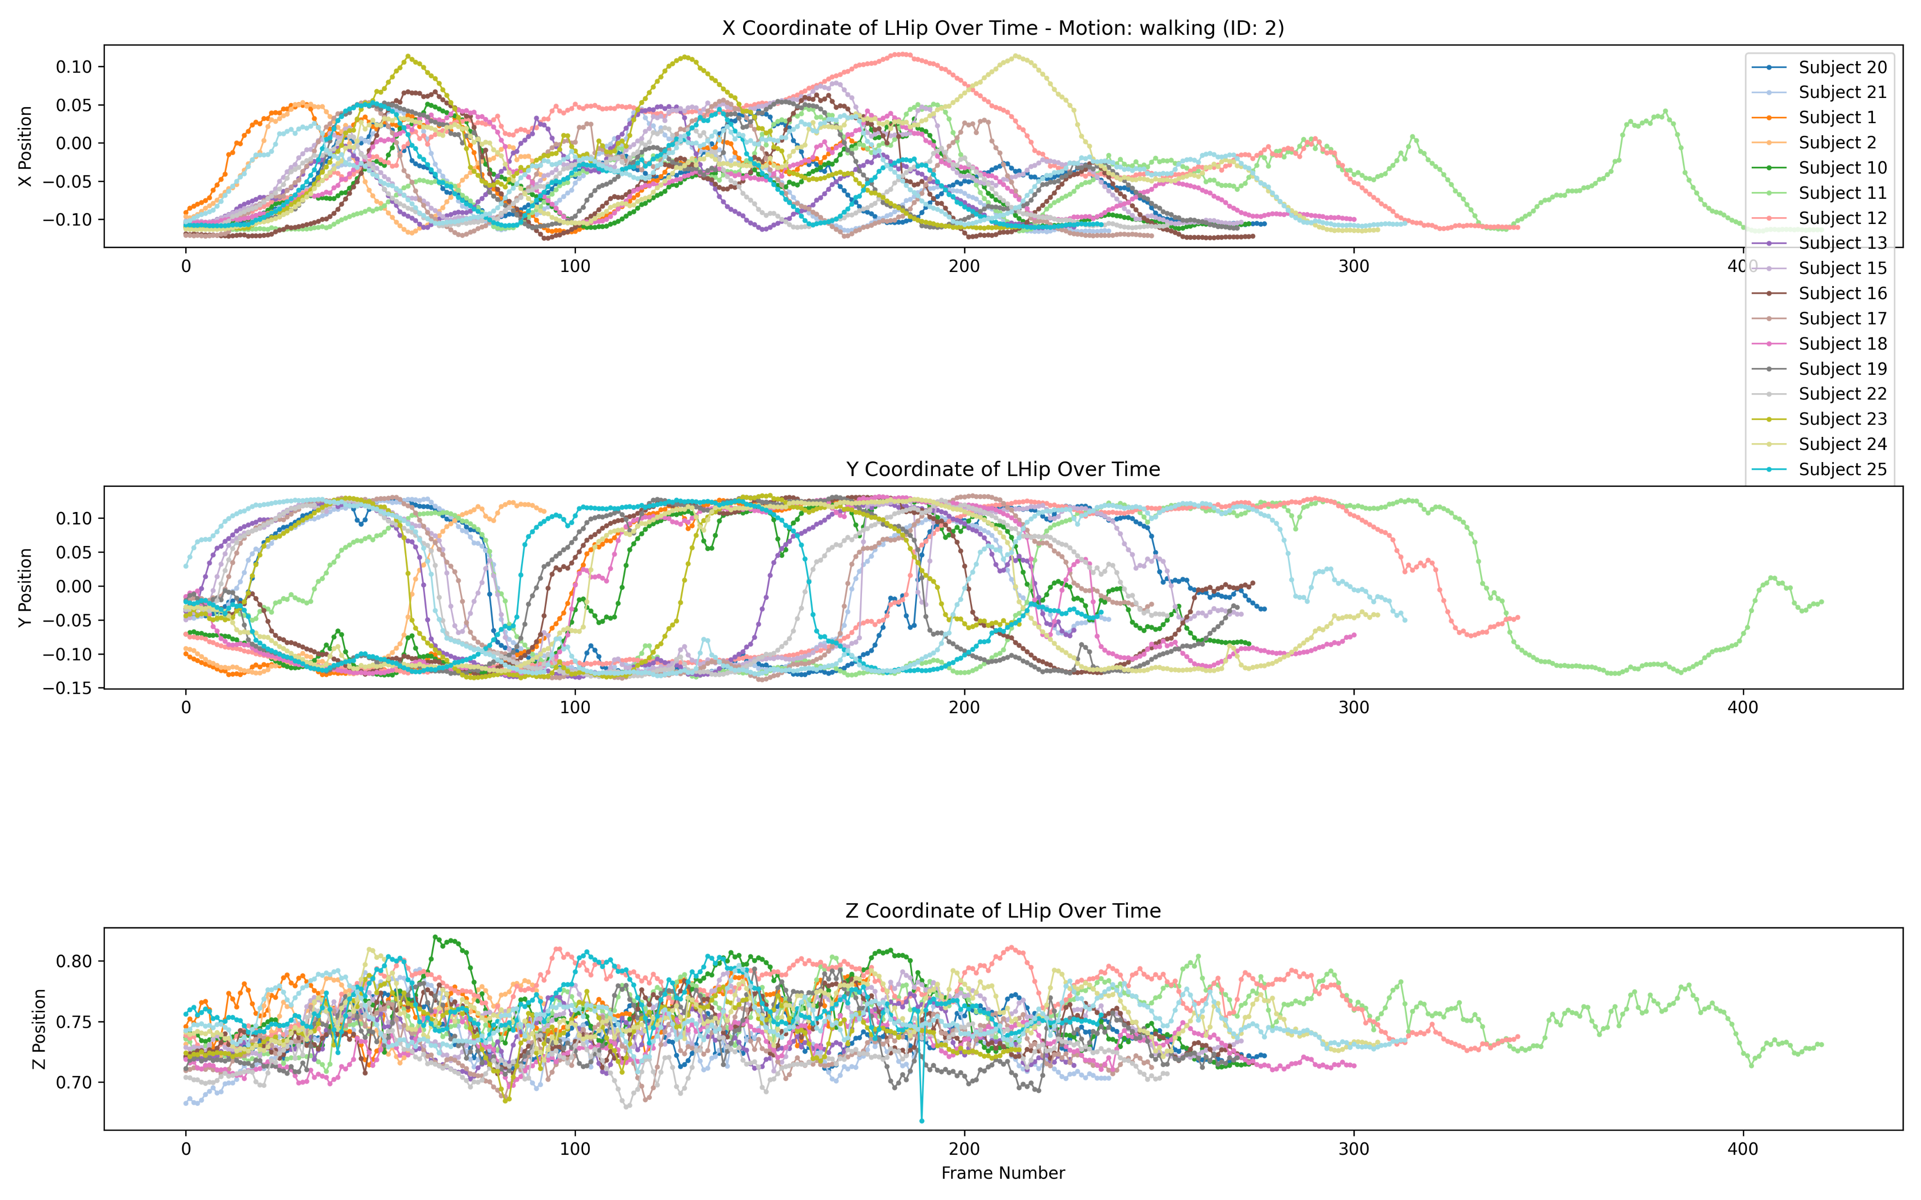
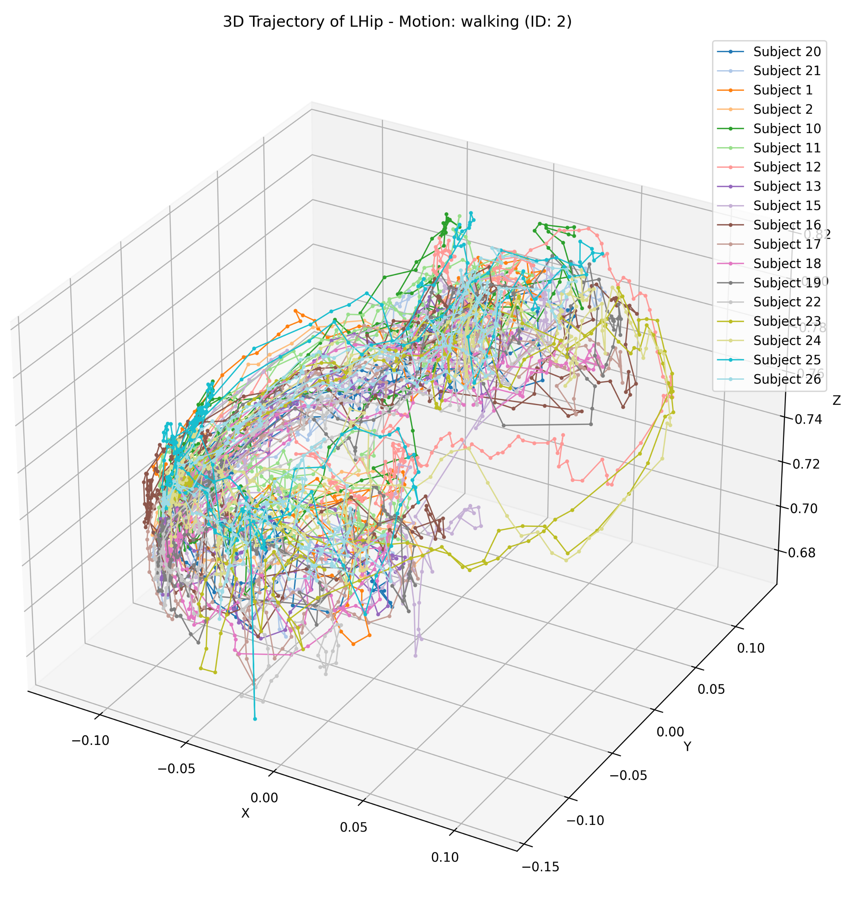
3D pose data
Joint trajectory across all subjects
Joint: Left Hip
Motion: Walking
Notes:
20 subjects here

Slide 7
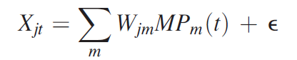
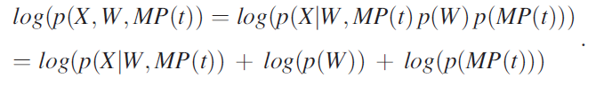
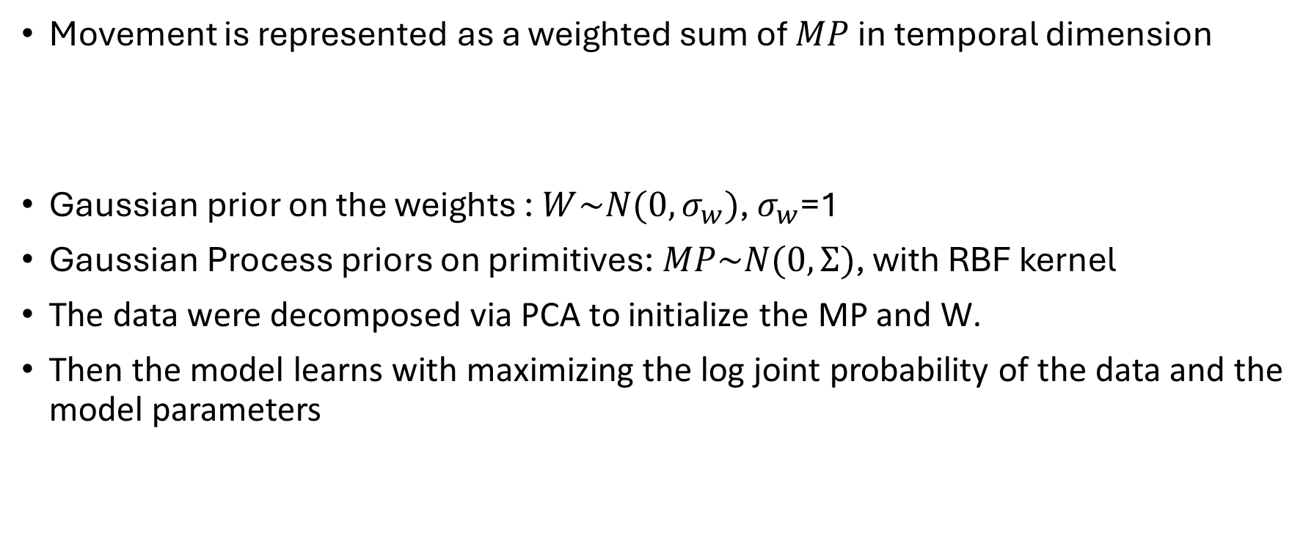
TMP model
Movement is represented as a weighted sum of $MP$ in temporal dimension
Gaussian prior on the weights : $W\sim N(0, σ_{w})$, $σ_{w}$=1
Gaussian Process priors on primitives:$MP\sim N(0,Ʃ)$, with RBF kernel
The data were decomposed via PCA to initialize the MP and W.
Then the model learns with maximizing the log joint probability of the data and the model parameters
Notes:
Bayesian generative model.
-were optimized jointly with maximum-a-posteriori inference

Slide 8
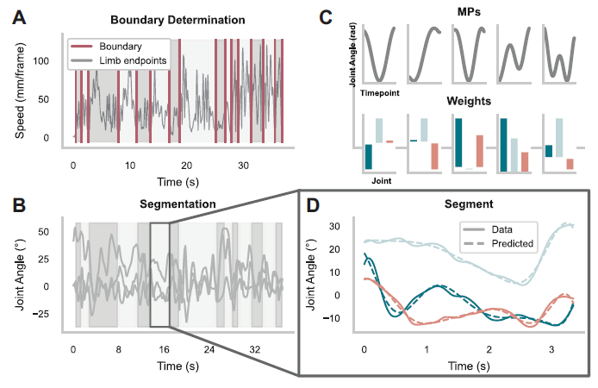
TMP model
Leh et al (2023)

Slide 9
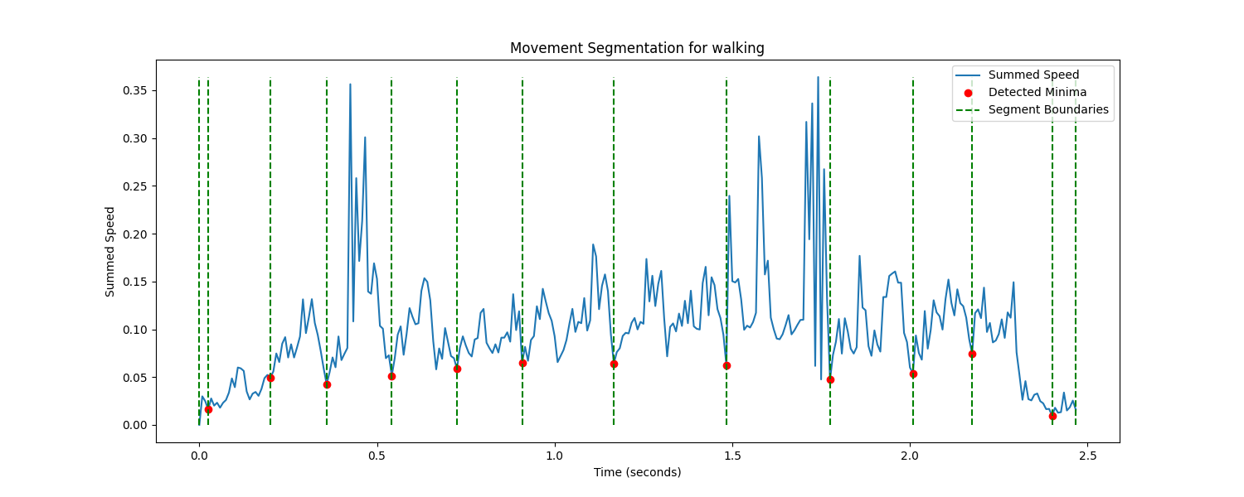
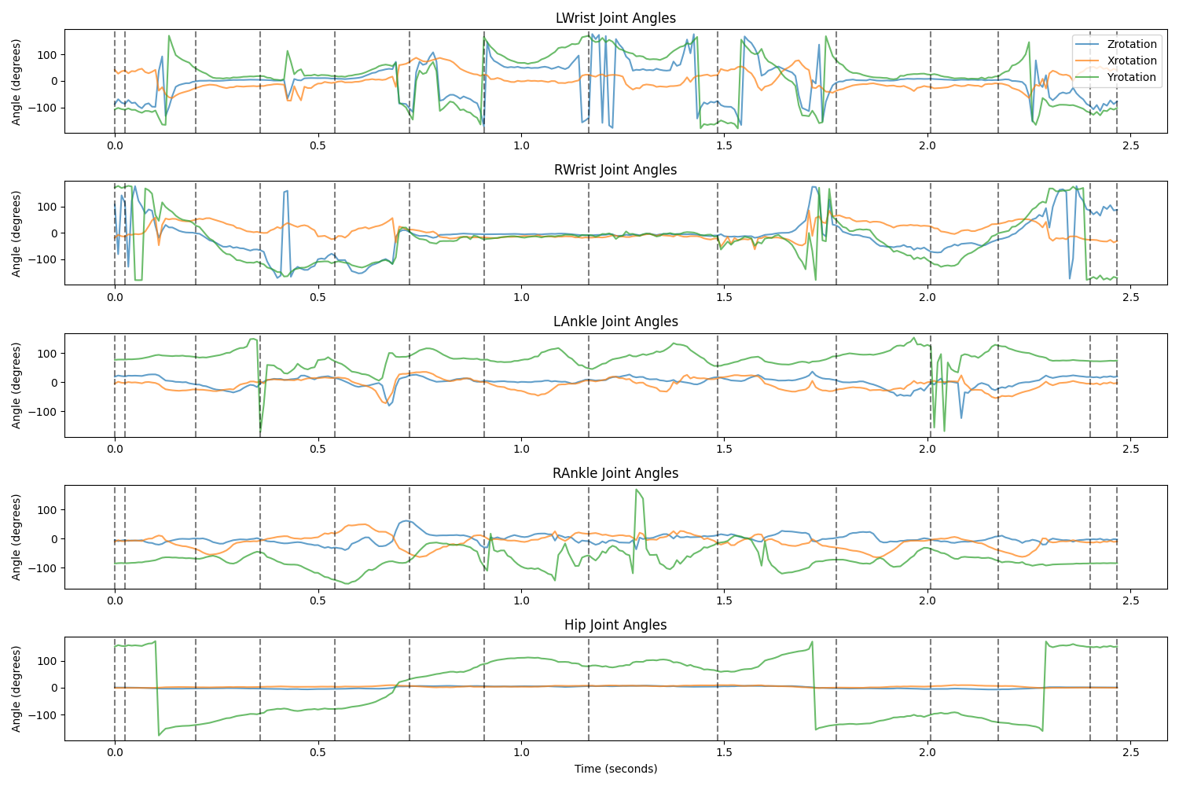
Data segmentation
Boundaries: min of summed speed of the wrist and foot markers limited to a min distance of 160 ms (19 frames)
Notes:
The joint angles of each movement sequence were partitioned into segments in the temporal dimension.

Slide 10
Training
Optimization:
Adam optimizer for initial optimization (faster but less precise)
L-BFGS optimizer for fine-tuning (slower but more precise)
Loss :
Minimizing the negative log joint probability
Monitoring:
Learning curve and VAF (Variance Accounted For)
Model Evaluation:
VAF & Laplace approx. of joint prob
Notes:
Training stops when the relative gradient length becomes smaller than a threshold (5e-4) This indicates the optimization has converged
Two-Phase Optimization Process:
Phase 1 (Adam): The model is trained using the Adam optimizer for a specified number of steps (adam_steps, default 1000)
Phase 2 (L-BFGS): Following Adam optimization, L-BFGS is used for further refinement (bfgs_steps, default 1000)
At each step, the model's loss is computed (negative log joint probability) and backpropagation is used to update the parameters

Slide 11
Achievements
Video sequences should be divided into separate movements:
Weights are constant during the time
Different performance time
Limited number of segments
Current stage:
Single motion extraction for each subject
Segmentation
Feed all segments into a TMP model for each motion
VAF = 70-80%
Notes:
Based on the paper, e should get 95% VAF
Feed all motions to one TMP model once: VAF = 30%

Slide 12
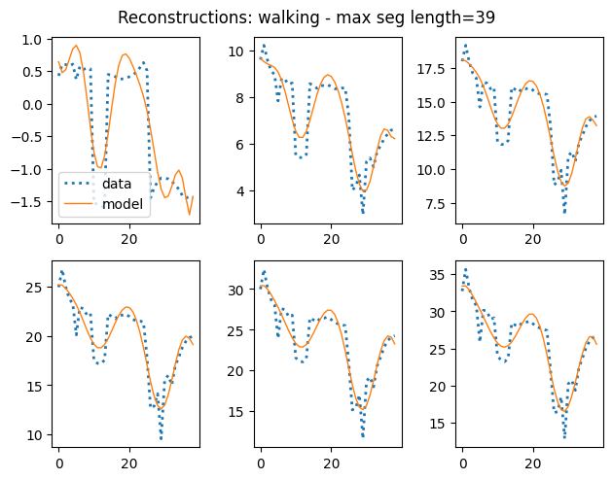
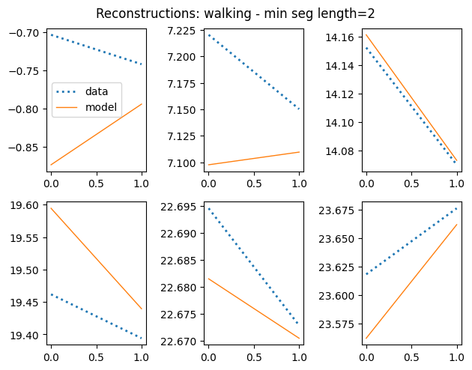
Motion= walking , 327 segments
num_mp = 10 , num_t_points = 30
VAF = 80%
Notes:
num_t_points defines the temporal resolution of the movement primitives

Slide 13
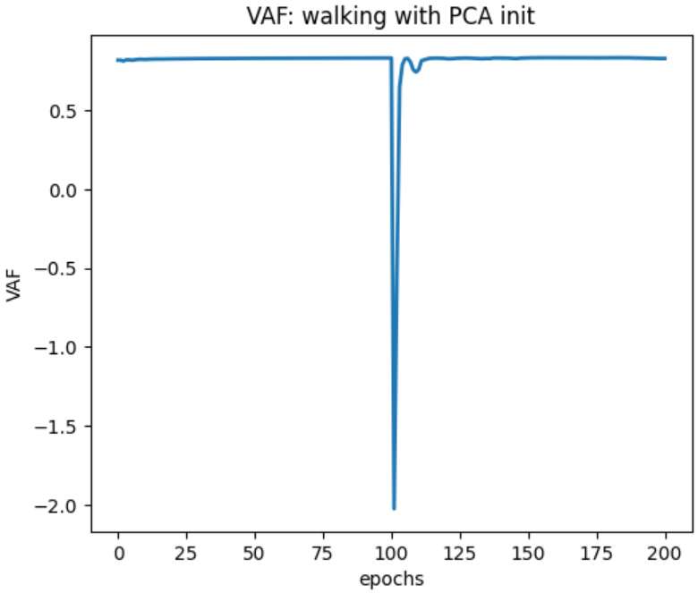
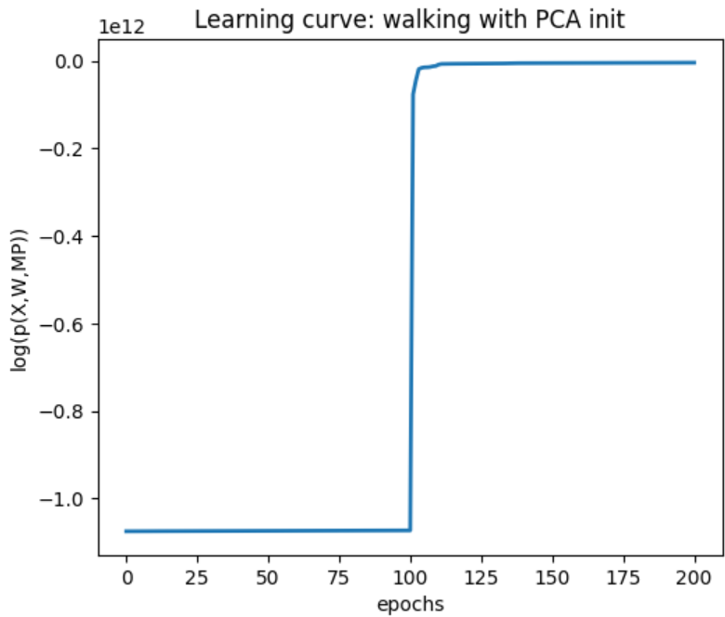
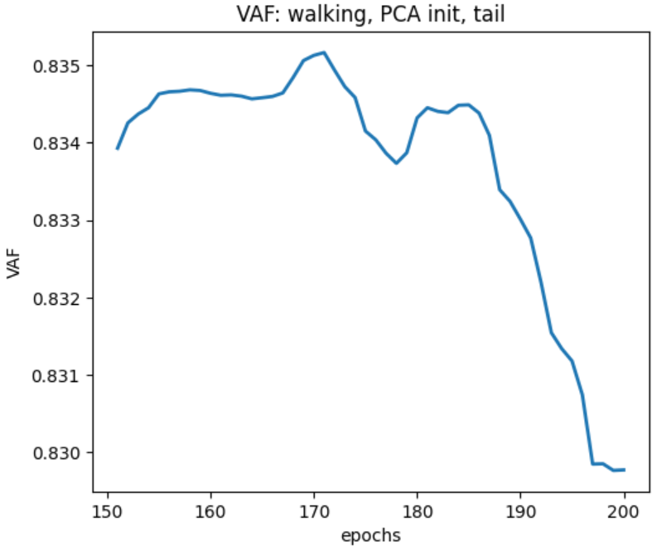
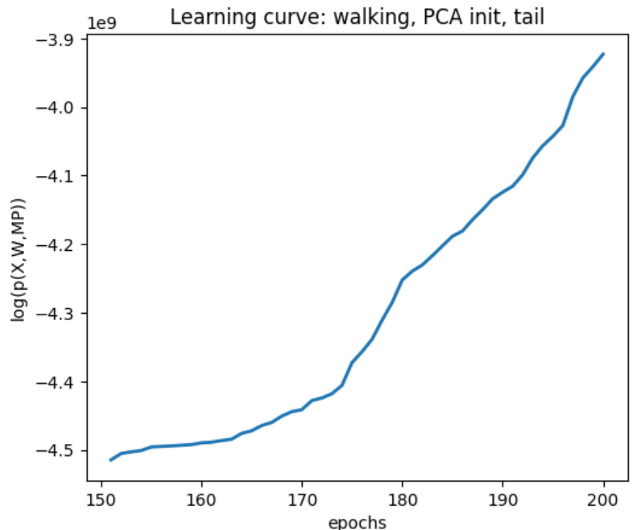
Notes:
num_t_points defines the temporal resolution of the movement primitives
Sudden drift of VAF : changing the optimizer

Slide 14
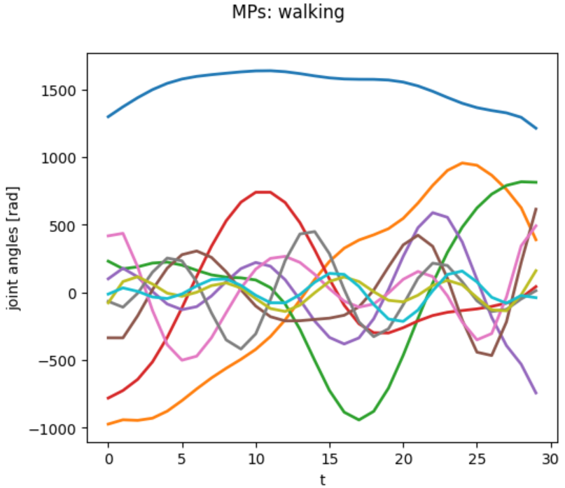
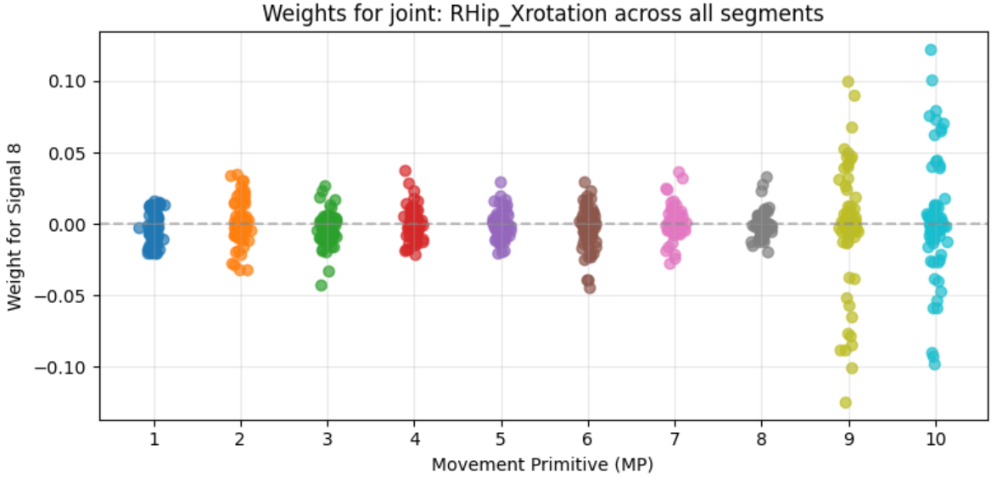
MP visualization

Slide 15
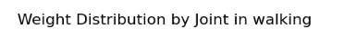
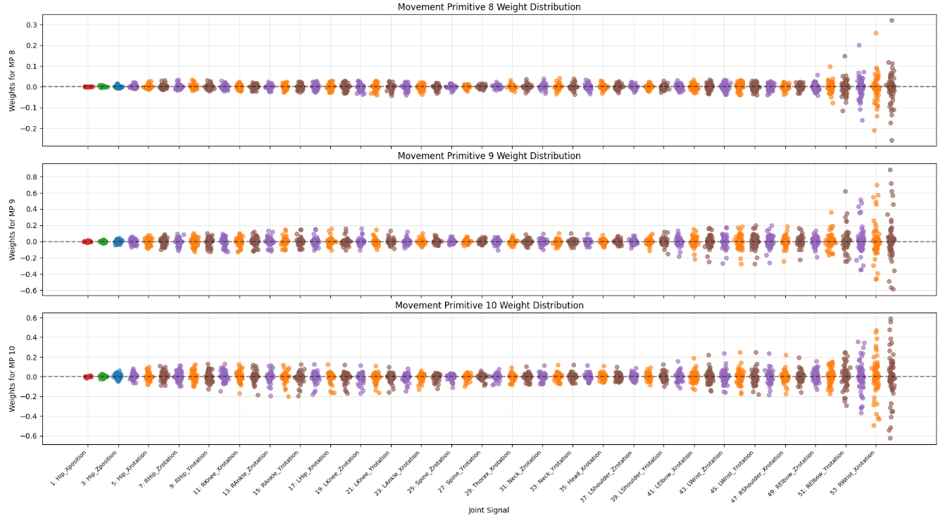
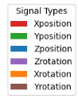
Weights distribution

Slide 16
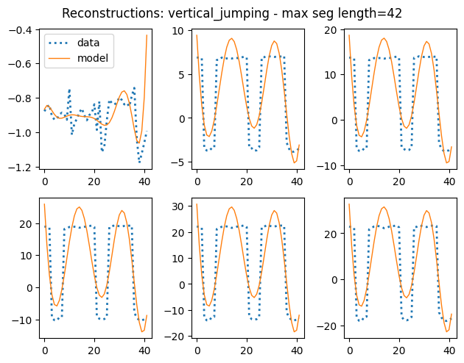
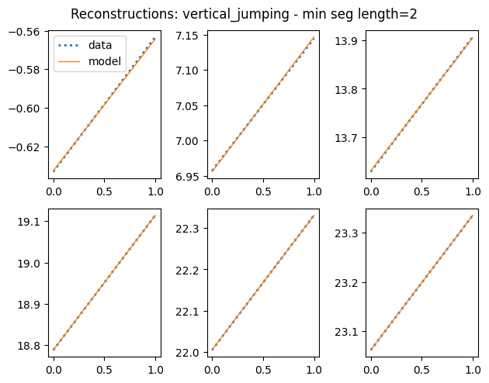
Motion= vertical_jumping , 241 segments
num_mp = 10 , num_t_points = 30
VAF = 67%
Notes:
num_t_points defines the temporal resolution of the movement primitives

Slide 17
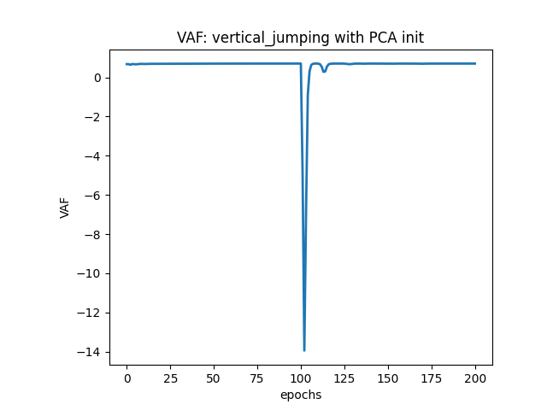
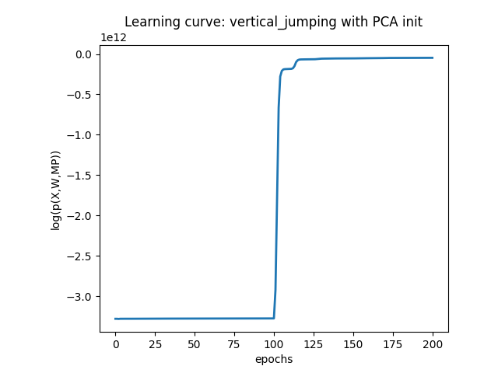
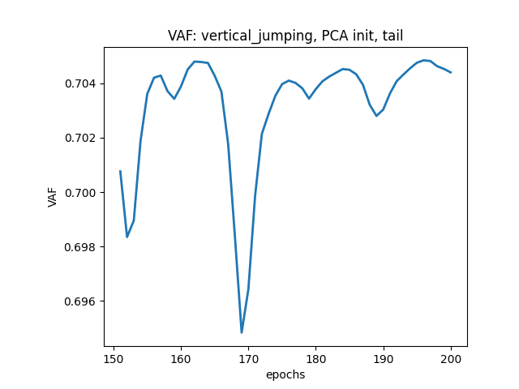
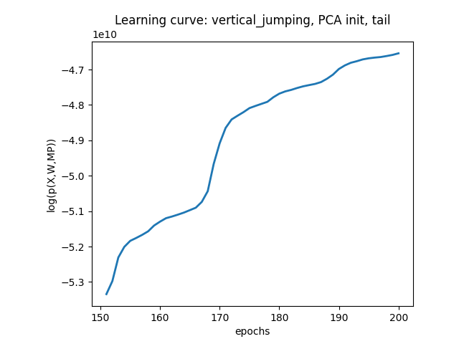

Slide 18
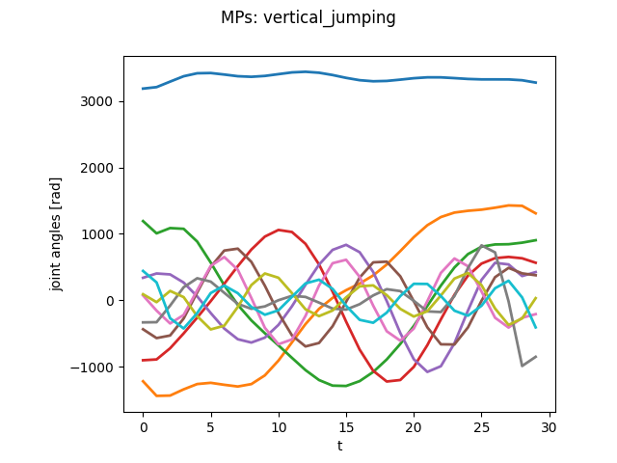
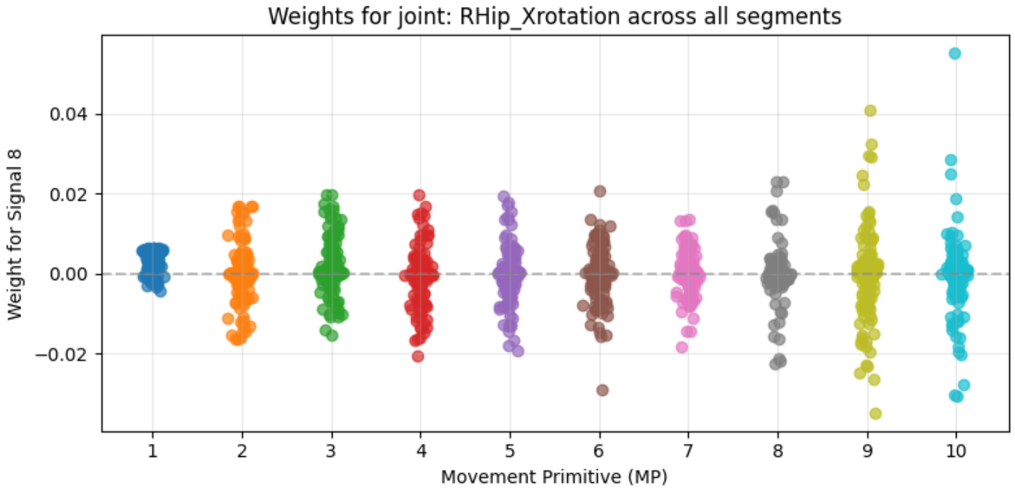
MP visualization

Slide 19
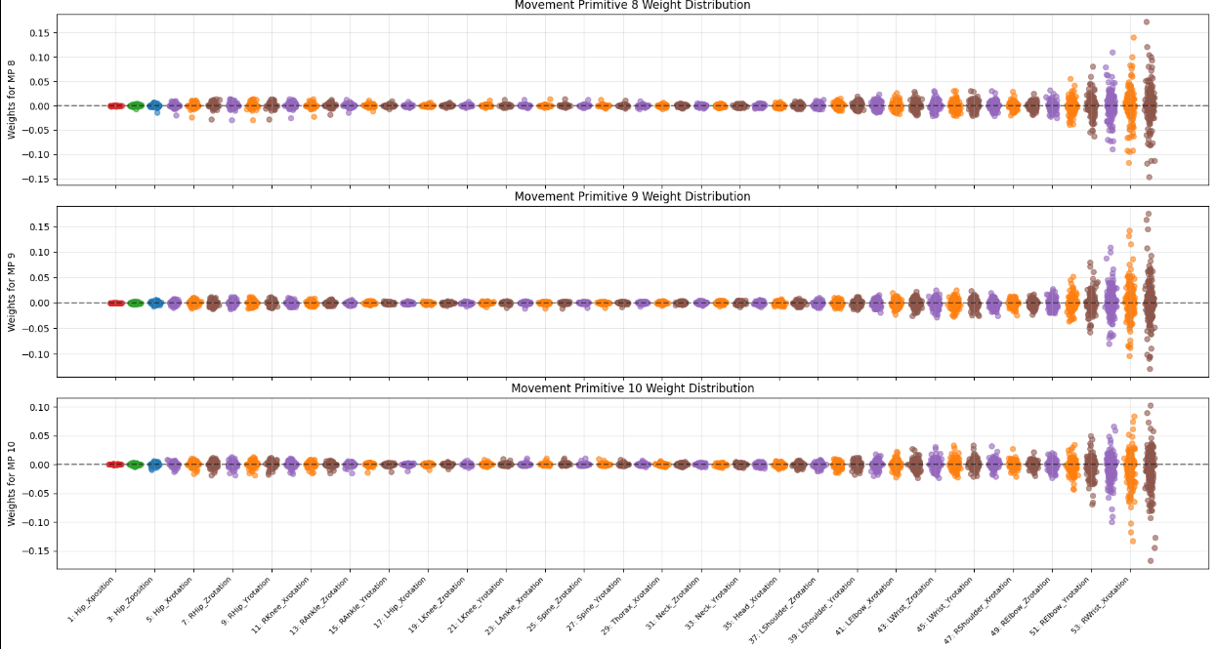
Weights distribution

Slide 20
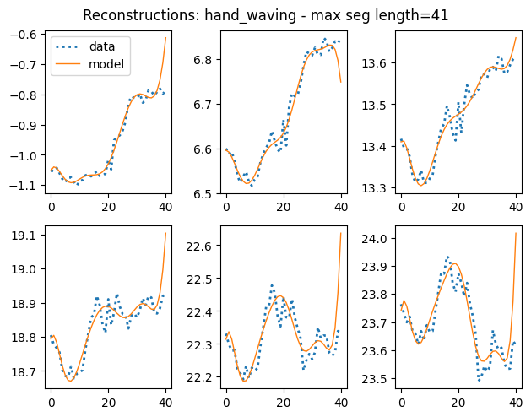
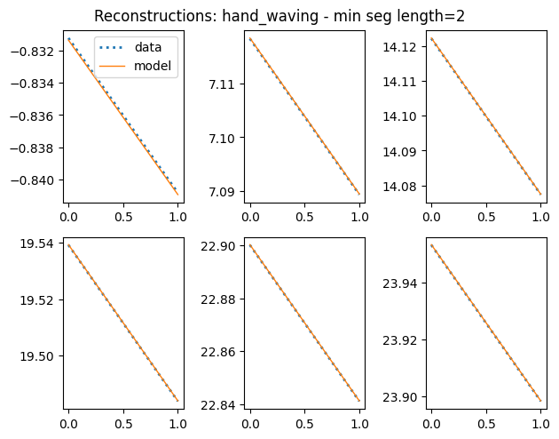
Motion= hand_waving , 224 segments
num_mp = 10 , num_t_points = 30
VAF = 70%
Notes:
num_t_points defines the temporal resolution of the movement primitives

Slide 21
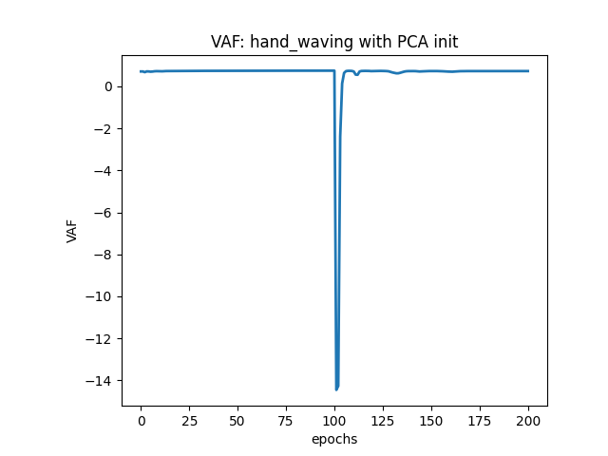
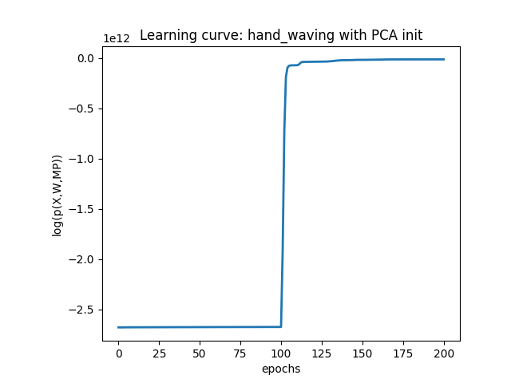
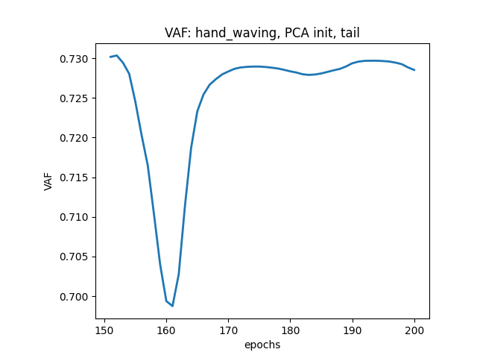
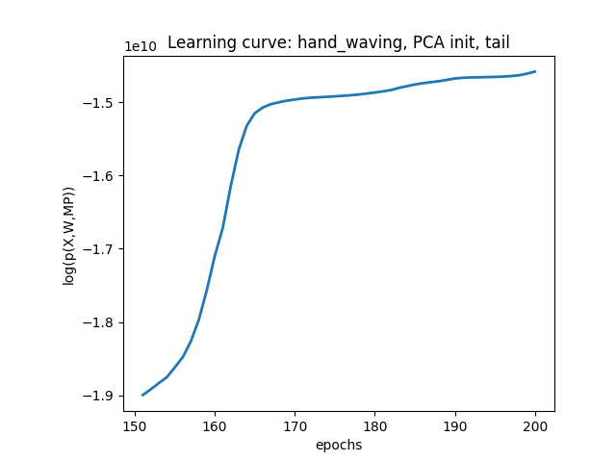

Slide 22
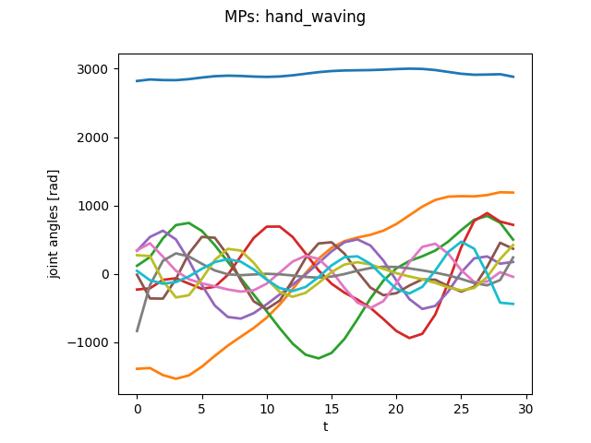
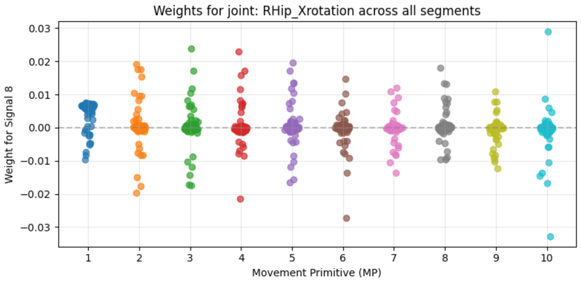
MP visualization

Slide 23
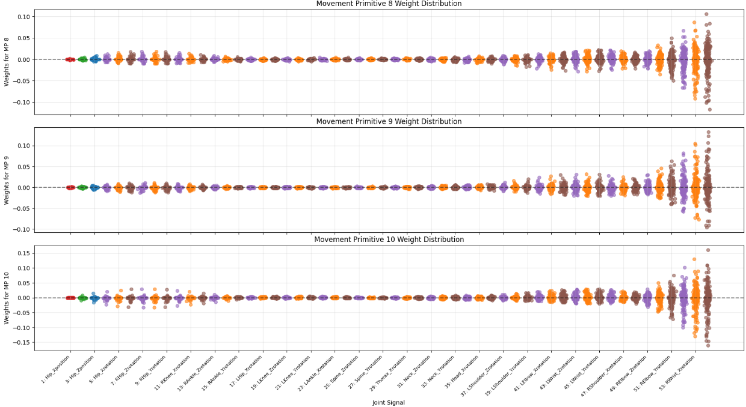
Weights distribution

Slide 24
Discussion
How can we create a unified pipeline that incorporates all of these models?
How to improve VAF?
Do we need movement reconstruction?
Different num of MPs and time_points?
Specific questions:
- Why using Laplace for posterior?
- Unrealistic range of joint angles for MPs

Slide 25
End

